Slide 1


Get It Growing
SDG Goal 12: Responsible Consumption and Production

Slide 2
OUR TEAM
Group 10
Hiruna Keshara 18020102
Samith Sankalpa 18020267
Hiruni Amarakoon 18020072
Ruwanthi Hemachandra 18020291
Sandani Wimalasiri 18020968
Ishara Wijekoon 18020951
Lahiru Udayanga 18020852

Slide 3
01
Selected Sustainable Development Goal

Slide 4
SDG Goal 12: Responsible Consumption &
Production
To ensure sustainable consumption and production patterns.
Efficient management of shared natural resources
Dispose of waste and pollutants
Reduce food waste and food losses
Reduce waste generation through prevention, reduction, recycling, and reuse
Promote resources and energy efficiency

Slide 5
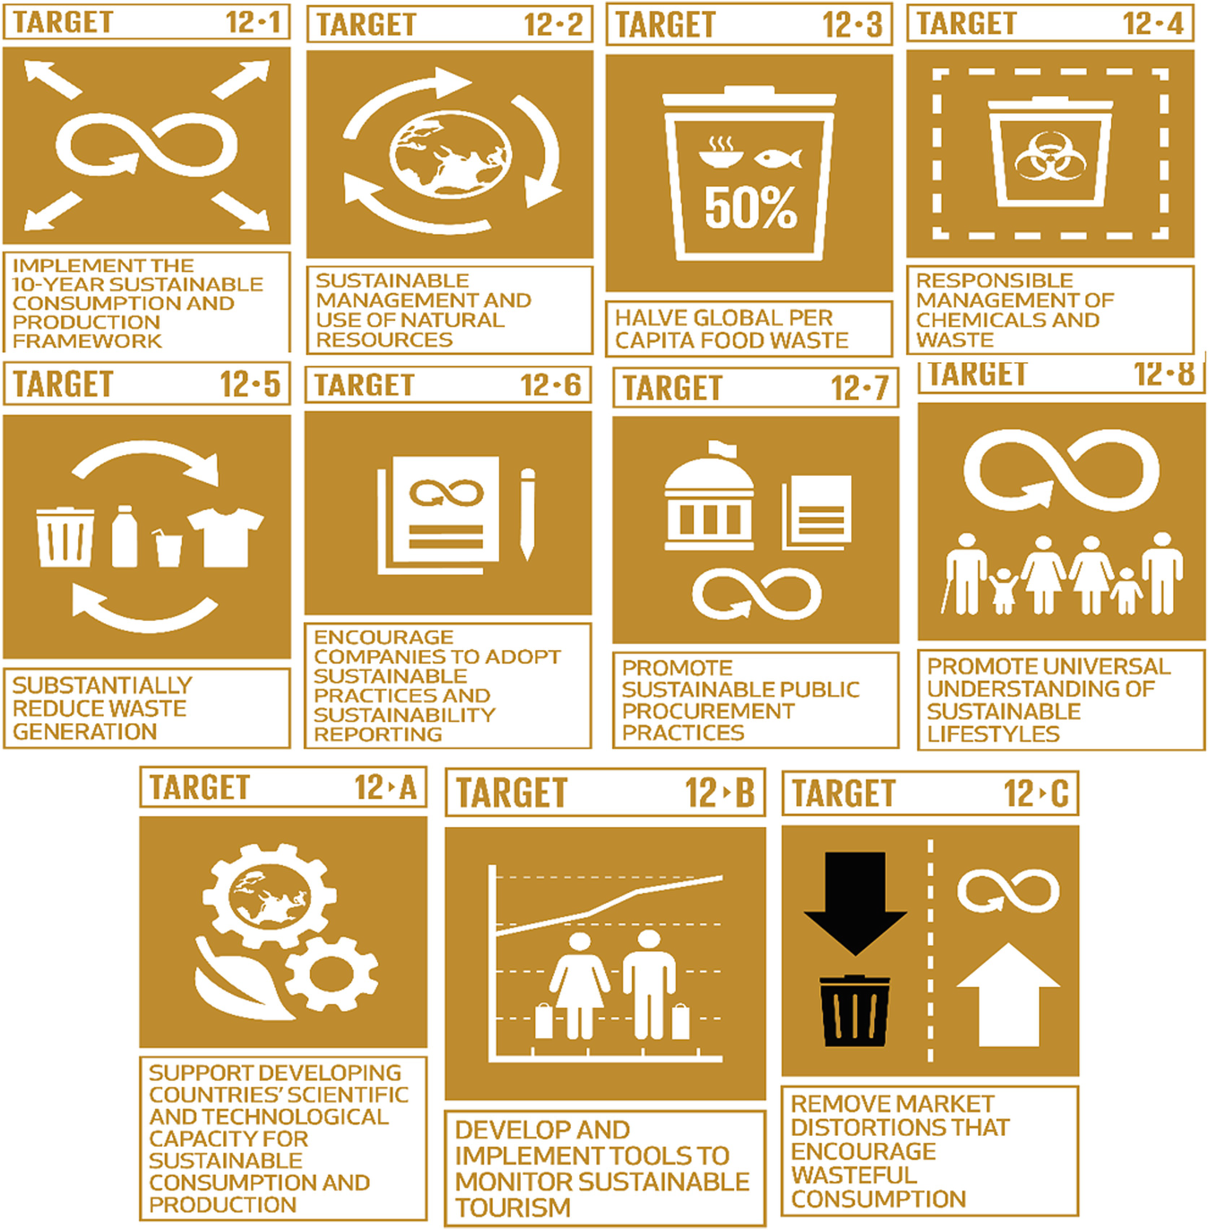
SDG Goal 12
Targets List

Slide 6
02
Existing Solutions in
Sri Lanka & the World

Slide 7
Existing Projects in Sri Lanka
The draft National Policy on Sustainable Consumption and Production by The Ministry of Mahaweli Department and Environment (MMDE) provides overall guidance concerning sustainable consumption and production aspects, covering 12 areas; air, water, food, built environment, energy, health, transport, education & communication, science and technology, industry, tourism, and waste.
A project on Sustainable Consumption and Production National Policy Support Component for Sri Lanka with support of SWITCH Asia supportive in selecting, adapting, and implementing suitable economic and regulatory policy instruments to promote SDG Goal 12.
The National Cleaner Production Program introduced resource pack on SDG 12 to universities and tertiary sectors as modules/ credits or as orientation programs to raise awareness and active participation.
Progress Monitoring System for National Food Production Program; a software solution under development to monitor the progress and maintaining the database to help policymakers to take critical decisions for planning cultivation programs and also exports and imports of food crops.

Slide 8
Existing Projects in Sri Lanka
Department of Agriculture official website (www.doa.gov.lk) provides agricultural technical information, access to agriculture publications, videos and radio programs
Wikigoviya website (www.goviya.lk) facilitates to have progressive dialogues on agriculture issues (Agriforum), establish public knowledge repository (Agripedia), and distance learning in agriculture and ICTs (e-learning)
Govi Mithuru project; a mobile agriculture initiative jointly implemented by Dialog Telecom, CABI International and Department of Agriculture to strengthen technology transfer in agriculture to the farming community
Market price Information Systems; ‘6666’ shortcode operated by Mobitel network, ‘977’ operated by Dialog network
The Hector Kobbekaduwa Agrarian Research and Training Institute (HARTI) maintaining a research database for post-harvest losses of almost all the important food crops in Sri Lanka on an annual basis.

Slide 9
Existing Projects in the World
The World Food Programme's P4P project; promote smallholder farmers’ entrepreneurship, provides training and assets to improve crop quality, facilitates access to finance and promotes marketing, procures grain from smallholders to be used as food aid to refugees and in school feeding schemes.
The One Planet Network; through six programs of Public Procurement, Consumer Information, Tourism, Lifestyles and Education, Buildings and Construction, and Food Systems gather expertise and resources from organizations across civil society, government, academia, and the private sector to help countries achieve their Sustainable Consumption and Production priorities.
The African Postharvest Losses Information System (APHLIS); collect, analyze and disseminate data on postharvest losses of cereal grains in sub-Saharan Africa

Slide 10
03
Problem Definition

Slide 11
1.3 Billion
2 Billion
Tons of food wasted every year globally
Worldwide go hungry or undernourished
13.8%
80%
Organic waste is short-term biodegradable food waste
Counted as Post-Harvest Losses

Slide 12
What are our target concerns?
A significant need to reduce the generation of food waste and post-harvest losses
Farmers aren’t updated about upcoming needs and trends of food patterns
Wholesale dealers are less aware of goods they need to purchase for the future months
No common platform for potential users and food waste generation parties (Ex: wholesale buyers) to facilitate direct producer-user linkages
Initiatives to reuse food waste; to feed livestock, to produce compost or bio-energy, etc.

Slide 13
04
Proposed Solution

Slide 14
Proposed Solution: Get It Growing
Mobile application for:
Wholesale dealers
Farmers
Potential wastage buyers

Slide 15
Expected Benefits
For wholesale dealers:
Works as a transaction processing system
Prediction of goods they need to purchase for the future months
Platform to sell wastage for potential buyers
For farmers:
A digital platform to directly contact wholesale dealers
Offer predictions of upcoming needs and trends of food patterns
Wastage buyers
Easily access the food wastage from wholesalers

Slide 16
05
Mockups for the
Proposed Solution

Slide 17
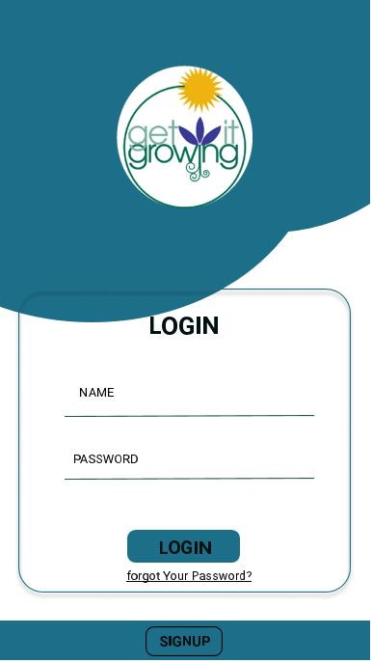
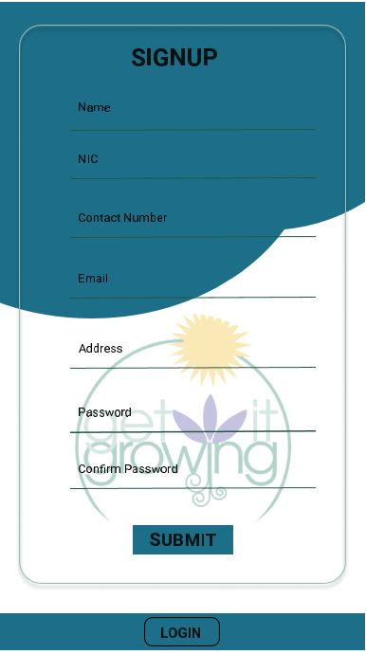
MOCK-UPS

Slide 18
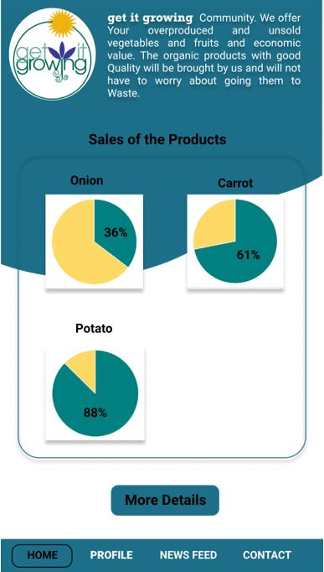
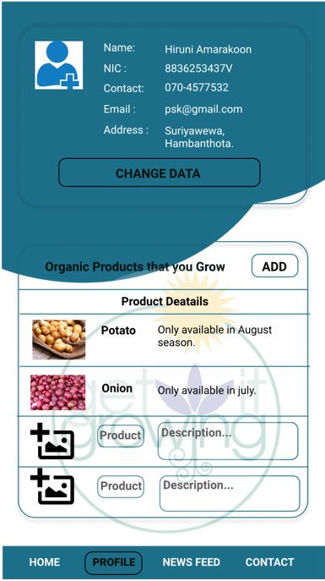
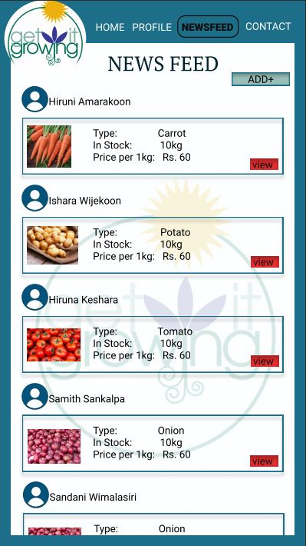

Slide 19
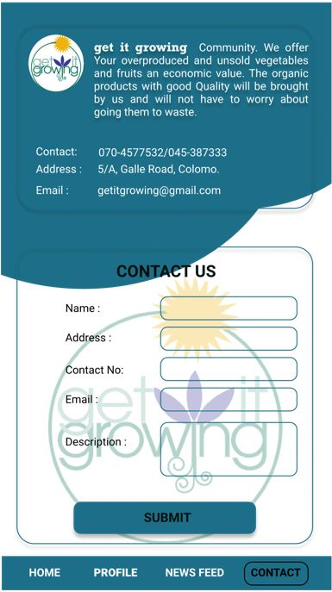
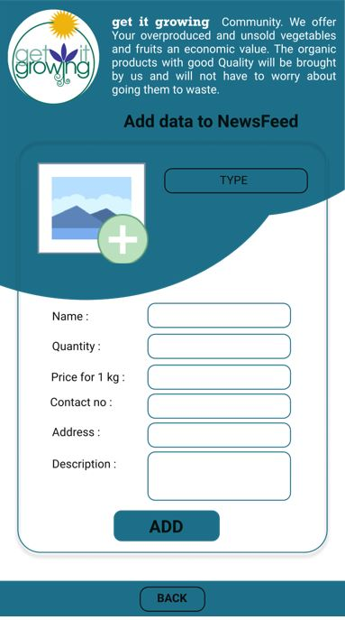
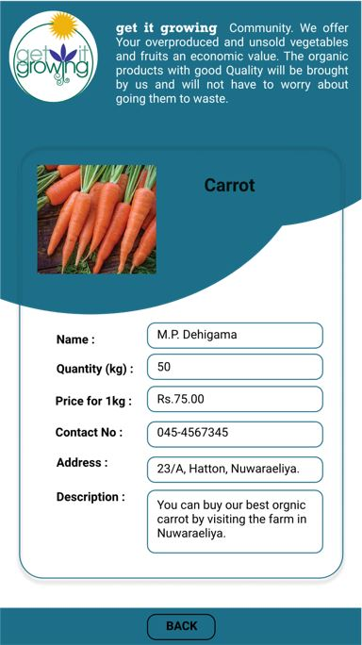

Slide 20
06
Design Thinking and Digital Development principles applied

Slide 21
How We Applied Design Thinking
User-centred designing.
Identifying real problems of end-users.
Brainstorm ideas to find the best and optimum solutions.
Prototype approach for design development and implementation phases.

Slide 22
Design for Scale
We hoped to apply the pilot project only to Dambulla Dedicated Economic Center. But this project easily implements to other Economic Centers with little configurations. If this project can apply to each center, it will help to calculate the whole consumption and limit the production for the local market according to the data and statistics this project supply.

Slide 23
Built for Sustainability
Reducing the wastage due to overproduction and mitigating market imbalances in supply and demand due to underproduction of vegetables and fruits would be a main success factor with support sustainability.
The users of the system will be allowed to use the service without any interruptions through their mobile devices. With the smart decision-making systems, users can effortlessly plan for their future and this would very helpful users with a low literacy level to grasp information effectively.

Slide 24
Data Driven Application
In order to accomplish our goal, this project must gather a huge number of data in the long run. For example, if we can gather the data for several years, the accuracy of the predictability will highly improve not only in general scenarios for the special cases as well.
With the simple user interfaces, easily-understandable charts and easily accessible data users will use those information to take necessary actions at anywhere anytime.

Slide 25
07
Digital Devices and Communications

Slide 26



Mobile Phones and Tablets
Computers
Sever
End users will access the information and record their transactions.
Data analyzing and report generation and communicate with users
Data and backups will be stored in cloud servers

Slide 27
08
Key Stakeholders
& Categorization

Slide 28

Key Stakeholders
Wholesalers
Farmers
Potential wastage Buyers
National Institute of Post Harvest Management (NIPHM)
Ministry of Agriculture Development and Agrarian Services
Directors of Economic Centres
Project Administration
Other Stakeholders
Developers
Designers
Project Managers
Project sponsors

Slide 29

Passive Consumer
National Institute of Post Harvest Management (NIPHM)
Potential wastage buyers
Active User
Wholesale dealers
Farmers
Directors of Economic Centres
Producer
Ministry of Agriculture Development and Agrarian Services
Worker
Developers
Designers
Project Managers
Enabler
Project Administration
Project Sponsors

Slide 30
09
Feasibility Study

Slide 31
Feasibility Study
Technical Feasibility
Each of these technologies is freely available and technical skills required are manageable.
To create the Interfaces of this mobile app we used the Figma open source Software.
For Documentation, we used Google doc, MS Word and also Google Drive.
WhatsApp and Zoom used as Communication methods.

Slide 32
Feasibility Study
Legal And Ethical Feasibility
System withholds from breaking any rules and regulations under the laws in the country
A personal profile for every registered user.
Sensitive data of users not exposed.
Ethically we have to consider how our group members think about this project and also those ethical points should include how we work together and how we interact with other members of the group.

Slide 33
Feasibility Study
Economic Feasibility
Development cost can be null: a team of undergraduate university students
According to our project, our development cost will be zero because we use open source software and freely available tools.
A possible cost for hosting the website online
Hardware cost: computer/smartphone devices
Schedule Feasibility
We have to fulfil the requirements and design the interfaces of our project within 3 Weeks.

Slide 34
Feasibility Study
Operational Feasibility
Internet connectivity is available for the users of this application.
The users have smartphone devices capable of operating these applications.
The users have sufficient IT literacy to use these simple applications and they can simply create an account and can get services.
When we consider our project it is a really good solution for current requirements.

Slide 35
10
Reality Gap
Reduction Methods

Slide 36
Project Design: Reality Gap Actions
The Principles of Digital Development must be followed to make the identified project more successful. Accordingly, there is a problematically large gap in evaluating responsible consumption and production.
From the user's point of view it is easy to solve the needs, problems and challenges of this problem. Therefore, to deal with the problems that exist in the Dambulla Economic Center as well as in other economic centers.
Maintaining interactions with wholesalers and farmers, in particular, makes this a successful and long-term impact.

Slide 37
Project Design: Reality Gap Actions
In order to accomplish our goal, this project must gather a large amount of data in the long run. It allows wholesalers and other parties to come to a proper conclusion.
Solutions are not pursued licensing fees or any other fees and can be issued through an open approach to increase collaboration within the digital development community.

Slide 38
Thank you!
Do you have any questions?
]]

